Slide 1
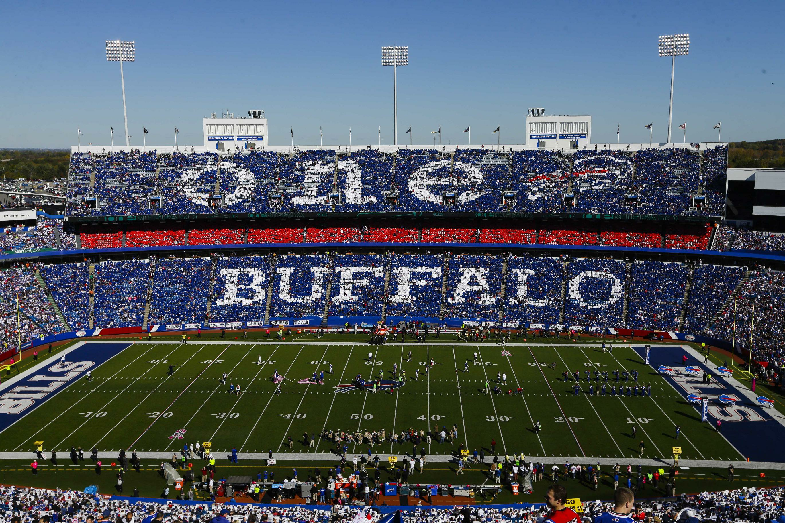
Team Friends
2014

Slide 2
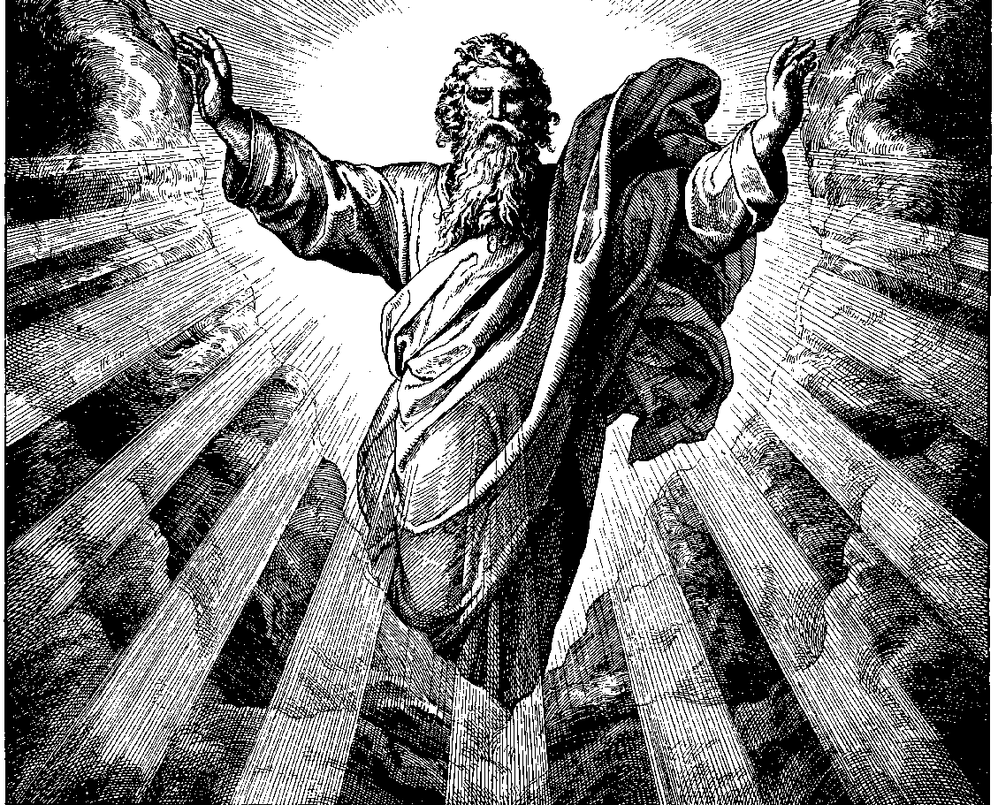
The End of the Season Review

Slide 3
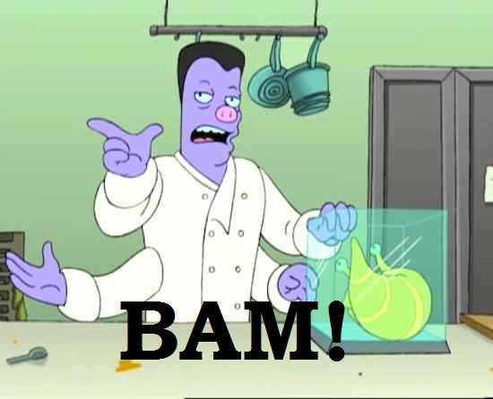
Friends, Countrymen, Timmies, Lend me your ears!
We have now reached the end of the 2014 fantasy football season here in Team Friends and we’ve endured many, highs, lows, changed team names, and upset victories. For this, the final OFFICIAL Recap of the year©, I figured I’d kick it up a notch
So come with me and you’ll be, reading a, Recap of my creation. Take a look and you’ll see into our past 4 months recreation. Lets begin, with a spin, looking back at the major highlights of the year….

Slide 4
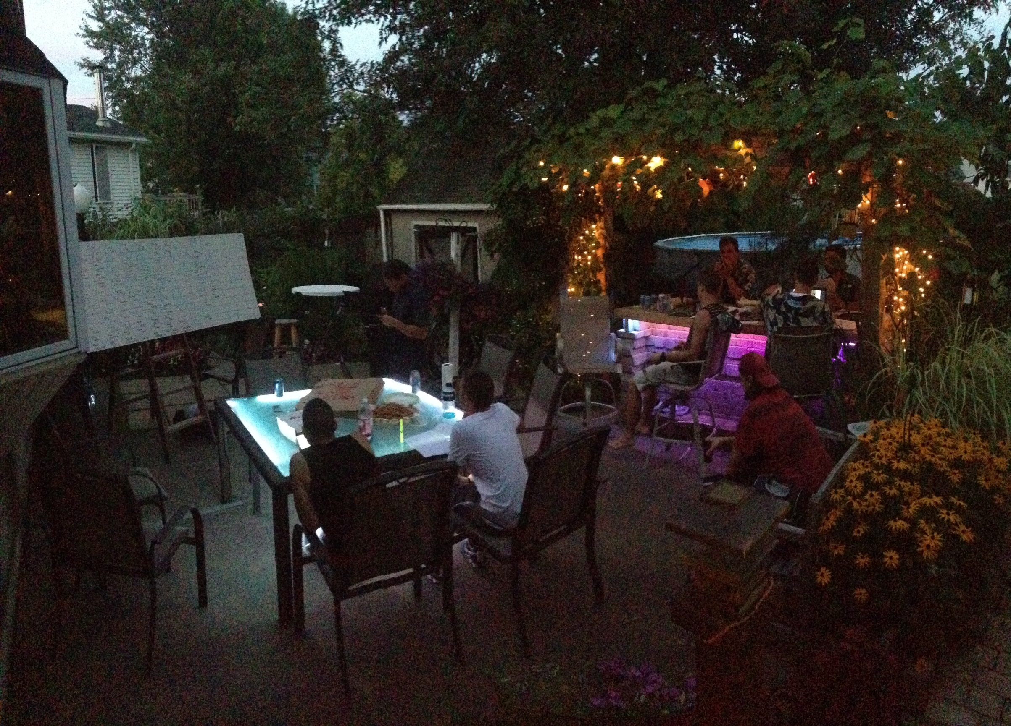

8/24 : The Draft
The High Holy day – the Draft Day. And what an eventful day it was. The high points:
Welcoming 2 new Managers
Matthieu “I can make my own terrible decisions!” Schwert
Josh “Watch me sneak my way into this league” Brown
Pfiefer’s call in picks, taking our suggestions hook-line-and-sinker
“Hey Pfiefer, Wes Welker is still on the table”
“Sam Bradford, best QB on the board man”

Slide 5
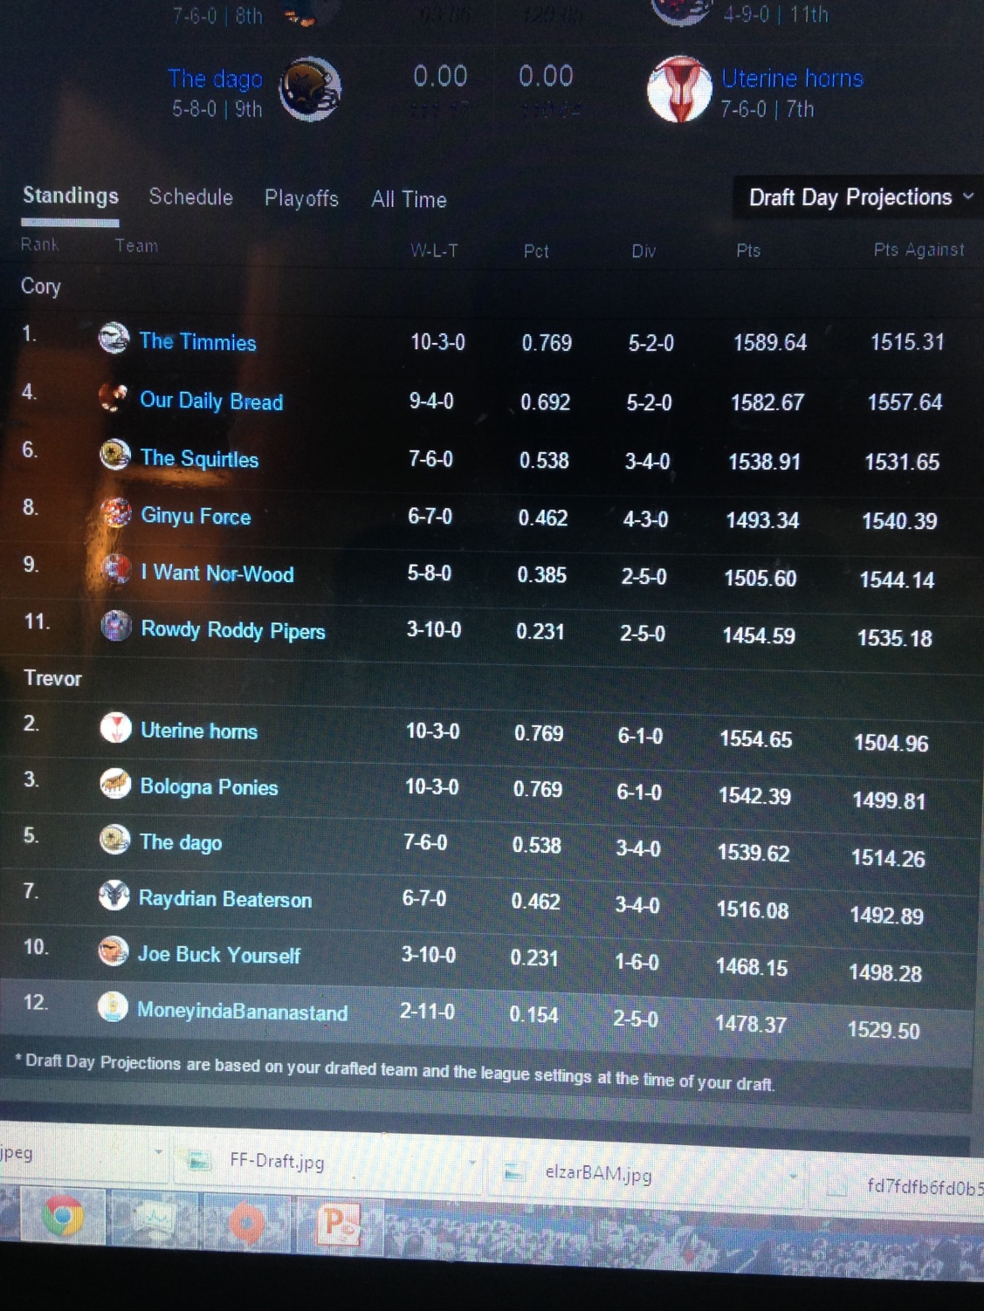
8/24 – The Yahoo Draft Projections
Not wanting to keep the Hungry Managers waiting, the Yahoo Experts Gave their grades posthaste, not waiting to have their decisions hampered and slowed down based on things like “facts” and “general common sense.” They went with their gut, Yahoo experts are paid to DECIDE GRADES, not waddle around in possibilities and numbers like a fag.
“Hey what did you decide your draft on,
numbers and ESPN projects? You wanna a
dick to suck on with that, ya Fag!?”
- The Yahoo Draft Experts
These dumb motherfuckers also had the audacity to grade the Honorable MoneyintheBananastand last in the league

Slide 6
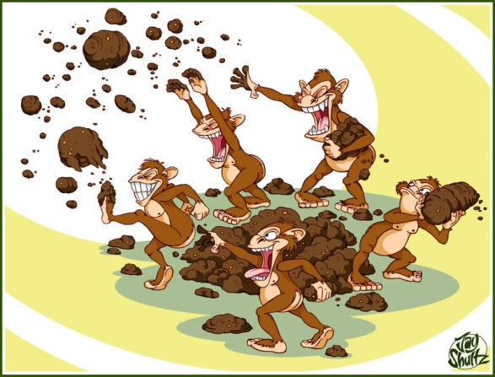
The Yahoo Draft Experts
Don’t laugh too hard, they still make more money that we ever will

Slide 7
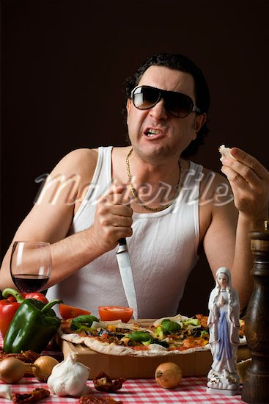
B-Day – The Day of the Bitching
Remember, Remember the Ponies bitch fit adventure.
I know of no reason Why the Squirtle-Pony trade of adhesion Should ever be forgot! Bologna Ponies and his knowledge of how to play fantasy Did the scheme contrive, To blow the Team Friends and the Squirtles All up alive.
Once the Dear leader, looking from above, Rallied the managers to dispose of the trade But, by the Italian’s blood, rising high and causing him to gush! With a gaping whine, the Ponies lighted up Line! “A stick and no mistake,” Cried the managers, “It was for the Squirtle's sake!” TO the ponies reply, “If you won't give me one, I'll yell as if I were two!”, But it was all for not, As the trade being or not being could not change the plot Of the Team friends league we hold dear

Slide 8
“The Trade heard ‘round the World”
It was October first, in the early throws of Fall, and a falling Rowdy Roddy Pipers and a drugged up Our Daily Bread closed upon a deal. In a trade that shocked the conscious of all who heard, in a deal that Gordon Gecko would be proud of, The Pipers traded away under-achieving Brandon Marshall (who has Jay Cutler throwing to him, or as glorious leader says “Orton 2.0”) to Our Daily Bread for the high apostle of the holy one on high, Demaryius Thomas (who has Peyton goddamn Manning throwing to him). For the Bread, this marked the writing on the wall for the season. For the Pipers, this marked the push he needed to get into, and subsequently lose in the first round of, the playoffs.

Slide 9
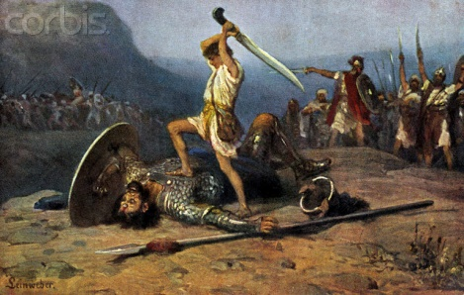
The Giant Falls
The Juggernaut of the beginning of the season, who was liken to the great Colossus built at Rhodes, was seeming an unstoppable force. Who could rise to approach this beast, this dragon? Would it be the surging Banana$? the high flying Timmies? Our dear leader?
Neigh, it was the lowly Squirtles, the unassuming, lowly Squirtles. It is often the over-looked who surprise us the most in life. Going into the week high on her past victories, it was I-want-Norwood’s hubris and the Squirtles resilience that finally knocked the I-want-Norwood’s off of the top of the league, a position she would never regain again.

Slide 10
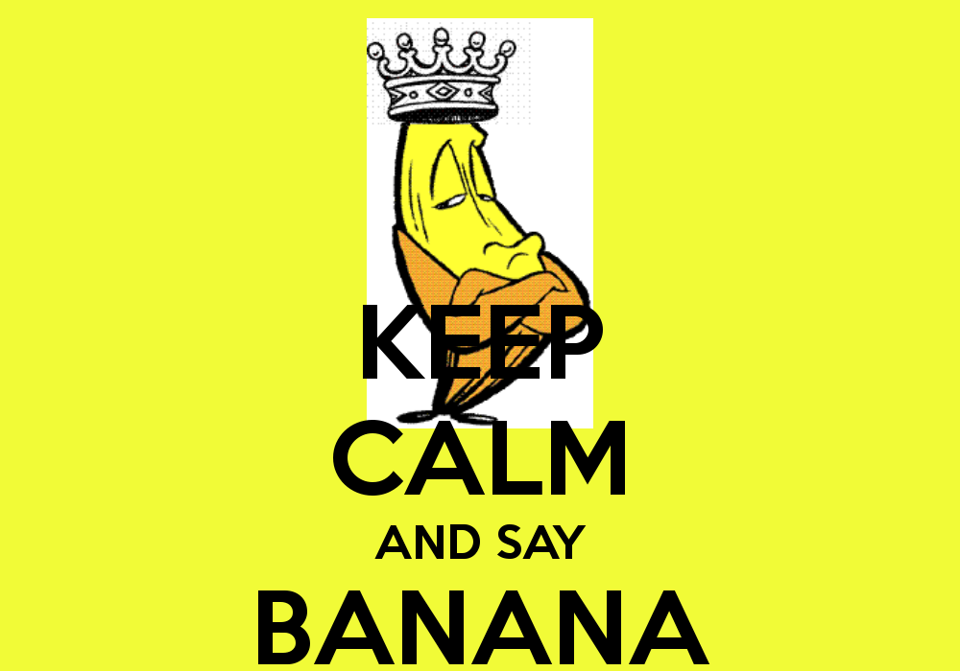
A New King Arises
With the downfall of the Norwoods, a new league leader was waiting in the wings. Hailed by the people as a savior, a fighter for all that is right, a general “good guy,” the MoneyindaBananastand took the reigns
Emboldened and fueled with the anger of being determined to come in last by the Yahoo fucknuts, MoneyindaBananaStand took the No. 1 slot, a position he would keep for the rest of the season
“All prosper under the rule of the Banana$”
-Everyone

Slide 11
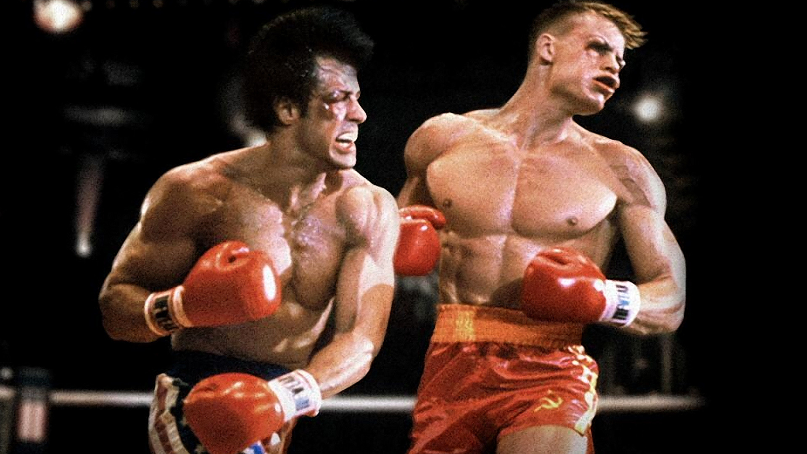
The King Falls, and a Champion Rises
The playoffs had begun, and the Banana$ were confident as a new challenger
approached. The “Timmies” had the largest arsenal in the league this year,
leading the league in total points by leaps and miles. After defeating
the not-so-rowdy Roddy Pipers last week the Warrior Timmies were ready for a fight.
But when the these two highest scoring teams met on the battlefield of Yahoo Fantasy Football,
the barn was not burnt, but a drawn out and bloody endurance test.
It all came down to MNF, were Jay Cutler was ready to light it up and
lead MoneyindaBananastand to victory. But then Cutler reminded himself
‘Why would I want to win and throw TD passes like a normal QB, when I can stick
a penis up my ass and ruin lives?.” The Timmies came away victorious and,
like the Miracle team in lake placid,
the Timmies would go onto victory and take the gold.
“I love hard cock and blowing dick!”
- Jay Cutler

Slide 12
Name Changes: A Commentary
Two Name Changes occurred this year:
“You Love Her” to “The Timmies”
In Obviously one of the best moves since Maxim Afenogenov’s highlight reel goal, the team formerly known as You Love Her had a very slow start, as teams constintenly questioned the rumors that he did, in fact, NOT love her. Then, the name change invoked the power of the TIM, and the marked the beginning of the rise to the Championship
“Ram D” to “Raydrian Beaterson”
In a move some experts have compared to the “Trail of Tears” and the “Nanking Massacre,” the name change chosen here has left us with scant to say except…. FOR SHAME

Slide 13
How it All ends, the meaning of it all
(a.k.a., the final rankings)

Slide 14
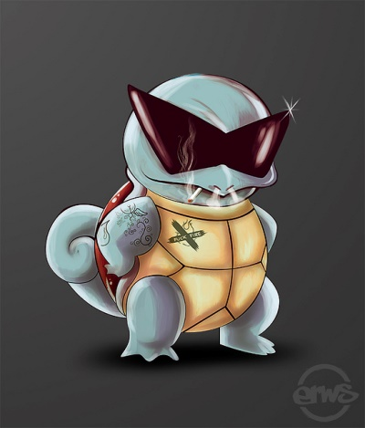
12. The Squirtles

Slide 15
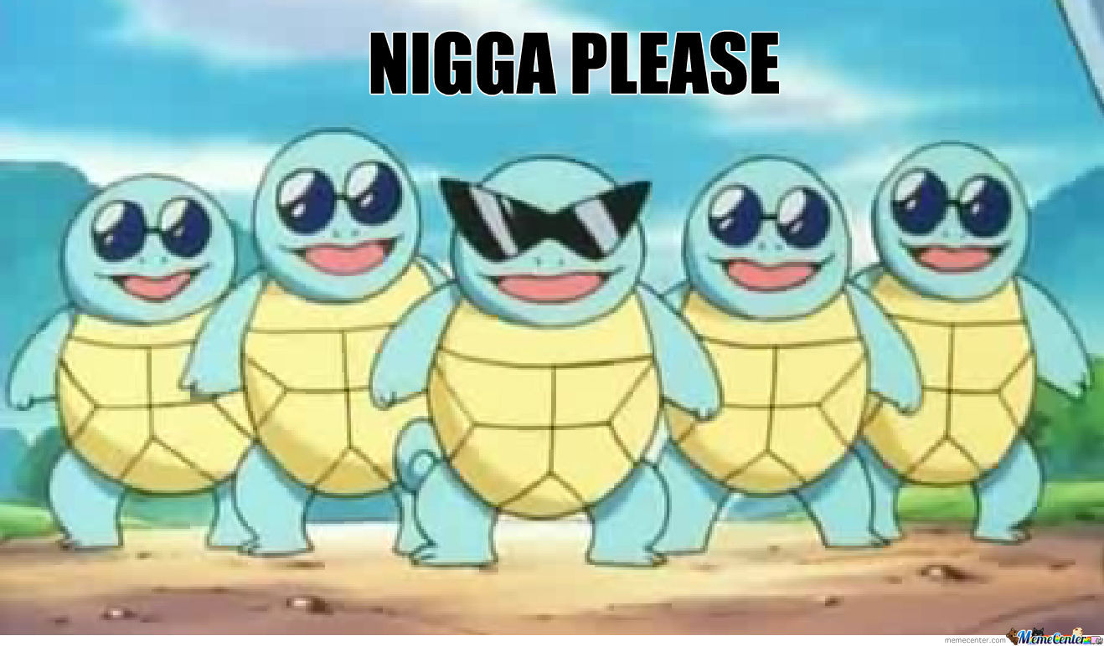
The Squirtles first and last foray into Fantasy Footballs was marked with some highs and many, many lows. From starting off going 2-0 and possible scaring the faithful that we drafted far to good of a team for him, the Squirtles true fantasy skills started to show by, well, not showing any. Benching the majority of his star players and starting ones that were either out or on IR was an interesting strategy that worked as well as the Hindenburg. Though, the league does owe him praise for being the first to take down I-Want-NorWood. The Squirtles, embraced his role as the caboose of the league, and will forever be remebered in the halls of the great fantasy players (or, more likely, be forgotten as quickly as we did Shaud Williams).
“Where’s Schwert?”
- Everyone at
Bobby Christmas

Slide 16
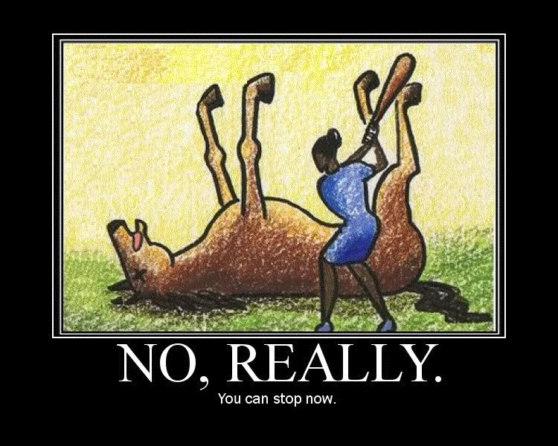
11. The Bologna Ponies

Slide 17
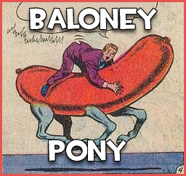
A perennial playoff contender, this year declawed, disheveled, and covered in feces, the Bologna Ponies had a rough year to say the least. The cornerstone of the Ponies team for the last 4 years, Drew Brees (who’s nyquil addiction has finally seemed to have caught up with him), was let down by his draft picks this year. Dealing with injuries percentage-wise was most comparable to Allied casualties in D-Day, the Ponies most weeks fielded a
team in casts and crutches. Like the
Colts of 2011, the Ponies hope to
forget about this season, and move
on with a high draft pick for next year
- “Enjoy the Dick Trophy!”

Slide 18
10. The dago

Slide 19
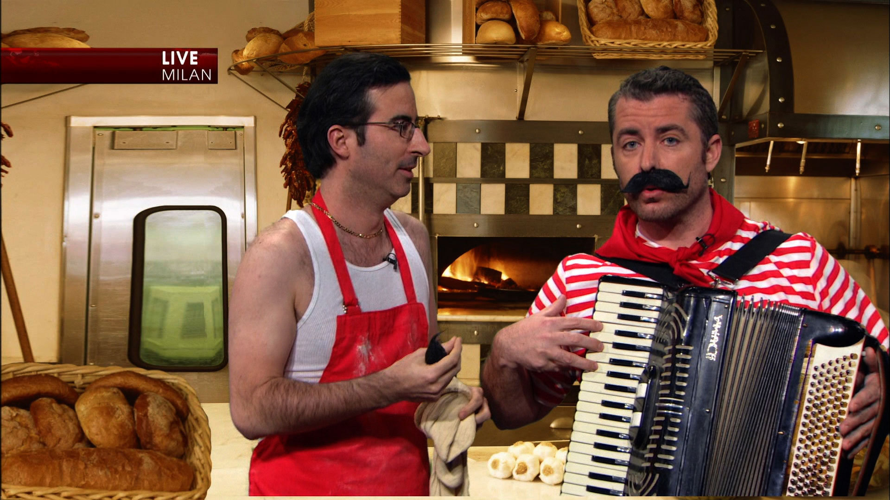
After a strong finish in 2013, the dago’s experienced a pasta shortage this year, as the team underperformed to the end. Matt “Baby Face” Stafford was a cancer on the dagos this year, since the loss of Megatron for the majority of the year proved to be too harsh of circumstances for a mediocre quarterback to handle. Though some draft day picks by the dago were suspect here, as the dago choose to draft not 1, but 2, I repeat 2 New York Jets… The Jets, might be one of the worst teams in football, definitely one of the most hated. Trying to use Chris Johnson and Eric Decker as floatation devices throughout the regular season ended predictably with the dago drowning in the unforgiving seas of Team Friends.

Slide 20
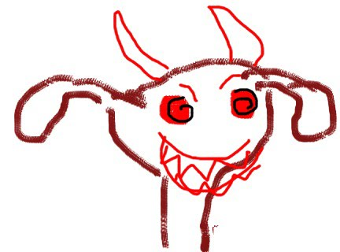
Uterine Horns

Slide 21
One of the new members of the league this year, the Uterine Horns adopted the title of the “disciple of Peyton” from the long-lost and departed member Glaub. As pointed out by Our Daily Bread, this may prove to be more of a curse than a blessing (blasphema!). Most likely kicking himself for not accepting the trade earlier in the year proposed by the Banana$ (he was poised to get Jeremy Maclin and Steve smith sr), the Uterine Horns went on to have an average season, missing the playoffs by hair, or more accurately, by a Lepo.
“Ouch!”
-Supra, previous
recaps

Slide 22
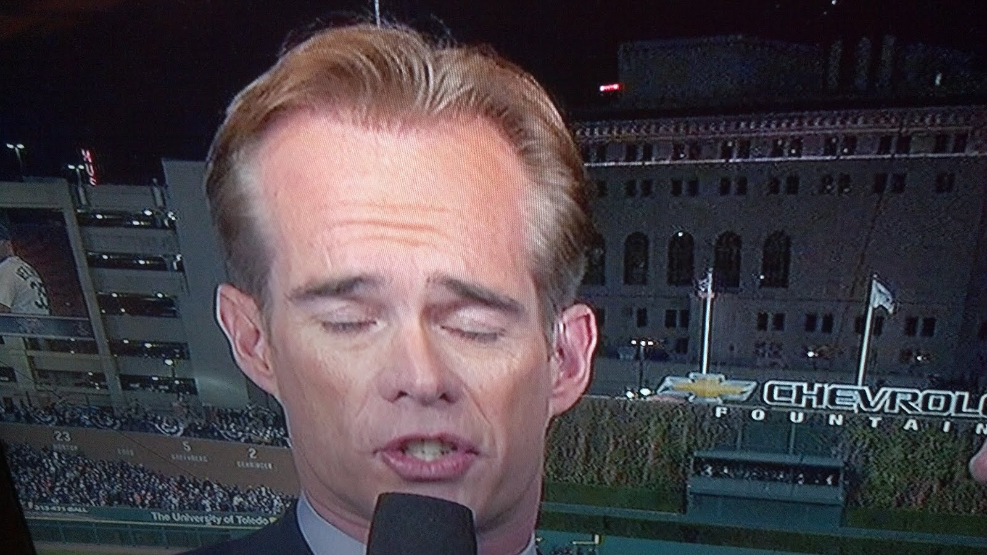
8. Joe Buck Yourself
“What’s your “O” face?”
- Joe Buck

Slide 23
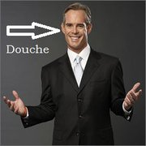
Joe Buck Yourself, the man whose mantra reads “Dagofast”, went “Dago-slow” this season (HA!). Having the same amount of luck as a citizen of Hiroshima on August 6th, 2014, Joe Buck had another disappointing season in the League. The epitome of the season for Joe can be summed up in weeks 6, 7, and 8 when Joe Buck Yourself’s opponents scored a whopping 555 total points. The path to victory is often paved with timely decisions. Decisions that Joe Buck Yourself failed to make, by numerous times having his bench players score more than he’s starting lineup.
“Some times, you just can’t win”
- Joe Buck yourself,
every time

Slide 24
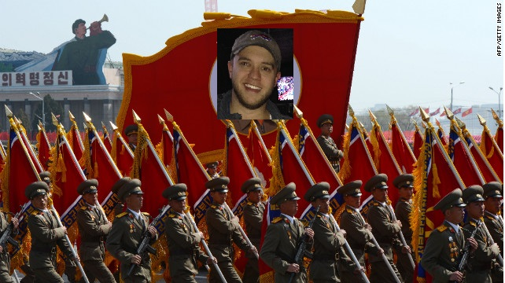
7. Our Daily Bread

Slide 25
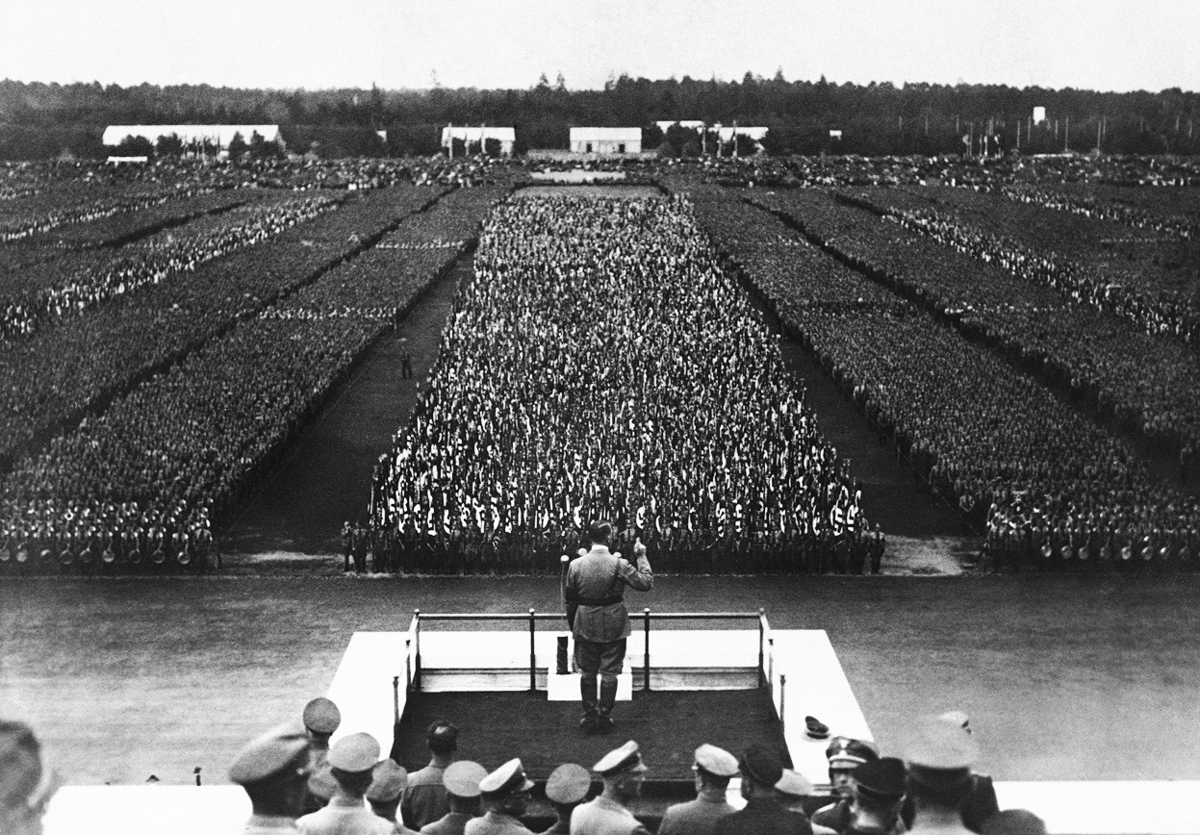
Our Fearless and Glorious leader lead the Team Friends into another victorious season, crushing all other leagues and solidifying Team Friends as the most respected and loved fantasy leagues on this earth. Our Daily Bread prepared hard for the season, putting together binders full of data and statistics to pick the best team possible. This strategy, as has happened every other time he’s done this, failed miserably and it was not 3 weeks into the season before there was calls of “firesale” and “trade with me, even if its me giving up the chosen prophet of the Peyton for the disciple of Cutler who if he was likened to a god it most likely be that bitch Loki, who always loses and tricks people into picking him for their fantasy team” – Our Daily Bread was quite long winded. As the Playoffs approached, one final push was made to try to entire the promised land of the playoffs, for the first time in Our Daily Bread’s Team Friends career. Alas, like the Buffalo Bills breaking down against a 2-11 Oakland Raiders team, who before this past weekend couldn’t figure out how not to shit their pants every time they walked on a football field, this dream would not be reached, and Our Daily Bread would fall short yet again.
Are these Snowmen fucking Multiplying?!
- Our Daily Bread, all
of post-Bobby
Christmas day
“Our Daily Bread; 2015!”
- Our Daily Bread, Week
3, 2014

Slide 26
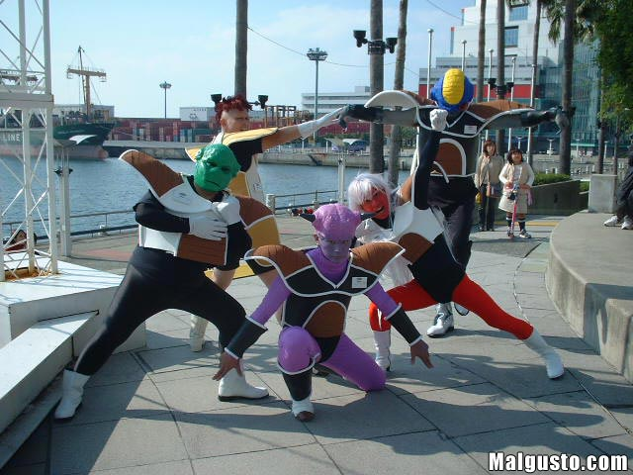
6. Ginyu Force

Slide 27
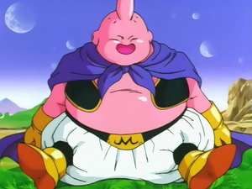
The Ginyu Force, some real ass gangstas, produced quite well this season given the hand dealt. Despite having both Sam Bradford on the team and Lesean McCoy (who wasn’t physically injured, but face it for what he produced for 90% of the season was injury inducing for fantasy owners), Ginyu Squad remained in the top 3 of the league for the majority of the season. This was in no way credited to Ginyu having Andrew Luck as his quarterback, because Andrew Luck is awful for fantasy owners, has a shitty first names, and throws small amounts of touchdowns.
What Ginyu Forces team was like once he reached the playoffs
- Analytics czar, The
Timmies

Slide 28

5. Rowdy Roddy Pipers

Slide 29
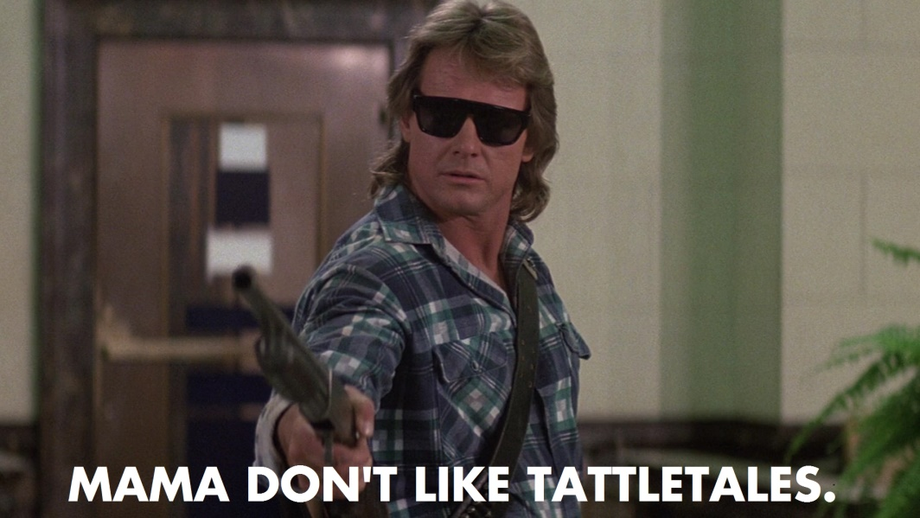
The Korean Andaconda, The Yellow Conqueror, Rowdy Roddy Piper himself had a solid year in the league, getting in on his own dollar instead of counting on Matt Schaub to play like a paraplegic (people don’t forget). The Pipers were the beneficiary of Demaryius Thomas for the majority of the season, who put up some blessed numbers, along with Matt Forte who is players who Cutler can apparently try to through some accurate passes to. Additionally, the Pipers prospered from the play of Big Ben Roethlisberger, who threw for 10 touchdowns in two weeks (which almost ties the number of women he’s most likely raped in his life). Alas, the Pipers season was short lived in the playoffs, as he went up against the champ and lost a painful, menacing matchup.
“I came here to win in the Playoffs and chew bubblegum; and I’m all out of winning in the playoffs”
- Rowdy Roddy
Piper

Slide 30
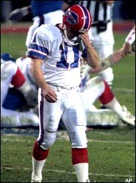
4. I Want Nor-Wood

Slide 31
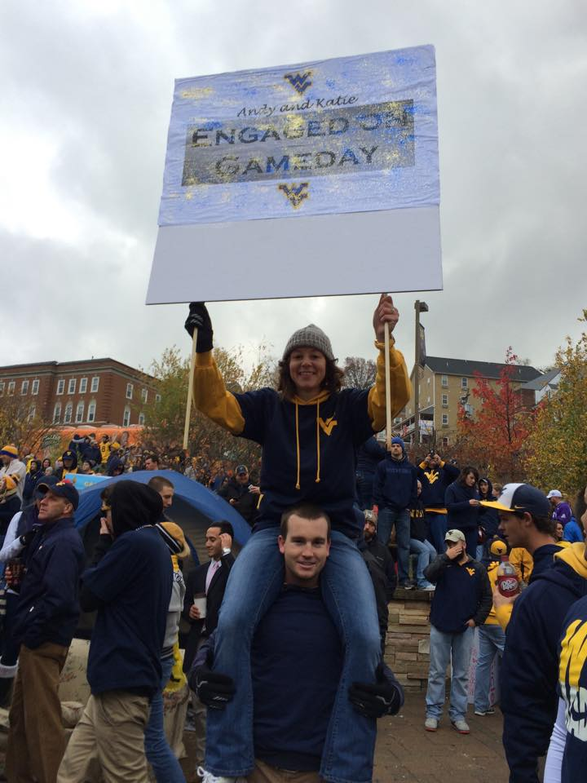
The dominate force of the first half of the season, I Want Norwood ran the hallways of the league like the stereotypical bully in every high school movie. Having won the running back lottery this season by scoring Demarco Murray, the Norwoods seemed unstoppable until she met a Squirtle who brought the Norwoods back to earth. Despite losing a few more games here and there, the Norwoods still ended up number 2 in the league, securing a first round bye. Alas, the bye would not help Norwood venture further into the wilderness of fantasy playoffs, as the Beatersons stole the victory right from underneath her nose. Either way I-Want-Norwood has proven
herself one of the most competent
managers in the league. (Does this mean
that men and women are equal now?)
“He Put a Ring on it!”
- Some girl in
West Virginia

Slide 32
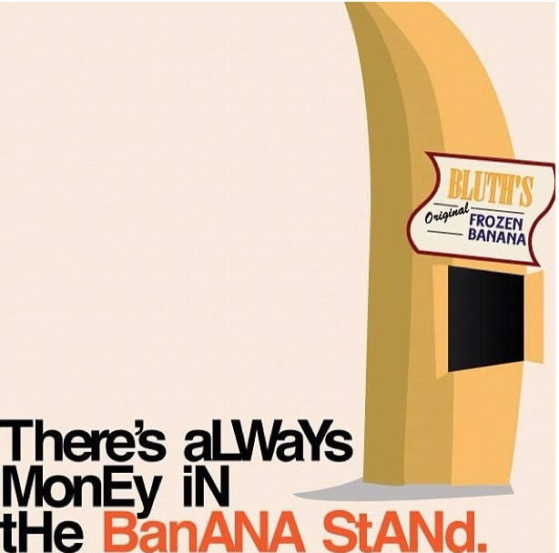
3. MoneyindaBananastand

Slide 33
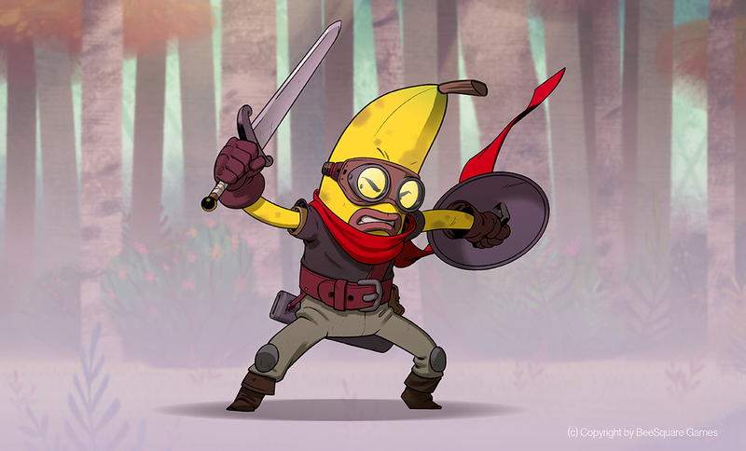
What can be said about MoneyindaBananastand that hasn’t already been said about every underdog team ranging from the Little Giants to The Big Green? That the rounded together a band of misfits to go to the top? That the experts picked them to come in dead last? That they didn’t win the big game like those other teams did? All of this and more is true of the wondrous Banana$, whose dominant performance in regular season this year made Sundays all the more enjoyable, while making playoffs all the more devastating. Led by a motley crew consisting of past injured players (Jermey Macklin, Arian Foster) and overachieving mediocre players (Cutler, Smith Sr., between 2-5 different Broncos running backs) the Banana$ put together a whale of a season. Alas, like the Epic Greek warriors from antiquity, the Banana$ were doomed by the football gods to fail. After suffering from hubris and declaring he no longer needed the gods, those football deities came back on Monday Night Football to remind Jay Cutler that he’s actually pretty terrible and should stop throwing to his tightend – thus securing the victory for the Timmies. All-in-all, Proud Season to be a Banana$.
“The new People’s Champ!”
-Dwayne “The Rock”
Johnson

Slide 34
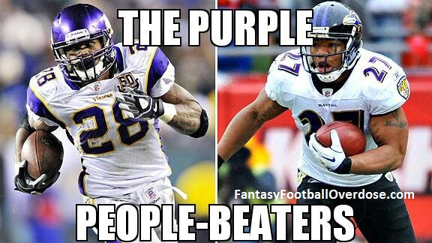
2. Raydrian Beaterson

Slide 35
Some people may claim that the Beaterson is a betting man, and these people may be right, as Raydrian Beaterson decided in the draft to make an investment in a certain team known for being Green, having cheese, and failing to a dominate Buffalo Bills Defense. Taking both Aaron Rodgers and Eddy Lacy seemed to be fools bet in the first 3 weeks, but eventually logic prevailed and Green Bay became the team everyone in state farm knew they could be. The Beatersons though were stuck in the Trevor league, under the rule of the Banana$, and with stiff competition in Corey, it seemed a long shot for the Beatersons to get in. Well, with some hard work, elbow grease and some key losses by the Uterine Horns, Beaterson found himself in the playoffs, and as if that was not enough, he found himself winning in the playoffs. As the Beatersons made his way down to the championship, vanquishing the Ginyus and former juggernaut Norwood, he finally met his match, in that of the high flying champion of the league.
“For SHAME!”
- The Banana$
running joke for
the season

Slide 36
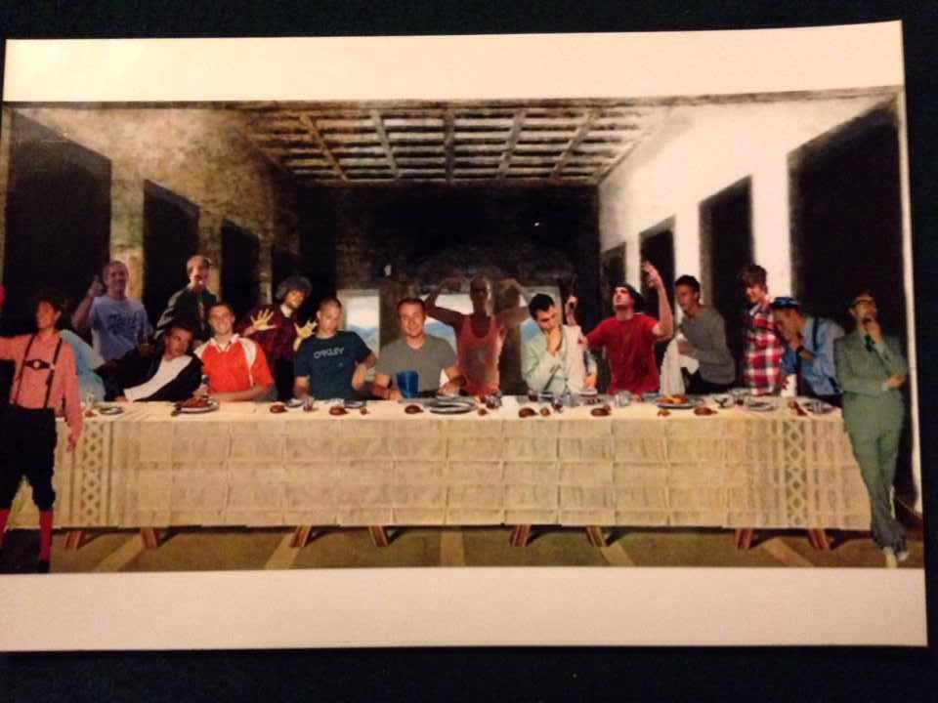
1. The Timmies

Slide 37
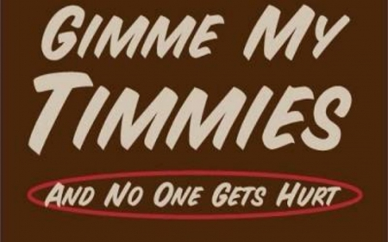
The Champ, the big kahuna, the overall point leader of the year this year was the Timmies, the aptly named. The Timmies exploited their position as Anaylitics czar this season to muster up a team filled with explosive potential. Once Aaron Rodgers got off his ass and remebered how to throw the ball down the field, the twin threat from Randall Cobb and Jordy Nelson combined with Antonio “fucking” Brown wasn’t frightening enough, if it wasn’t for the twin attack of Jamal Charles and Mark Ingram running train on defenses and endzones for the season. The only chinks in the Timmies armor cam from; First, the team name “You Love Her” which was void of any Timmy Power, and Second, Tony Blowmo, who was at best inconsistent for the year (except for December what I’m sure is the first time in his career and also a sign of the apocalypse). The Timmies would move one through a surprisingly slow start to become 2014 champions of Team Friends, for which praise should be given (fuck you). Good thing he’ll at least have the last pick in next years draft. Oh wait…..
“Timmy Tom, Timmy Tom……… bbbbiiiiiiiiiiillllllllllllllllllllllyyyyyyy”
- The Timmies

Slide 38
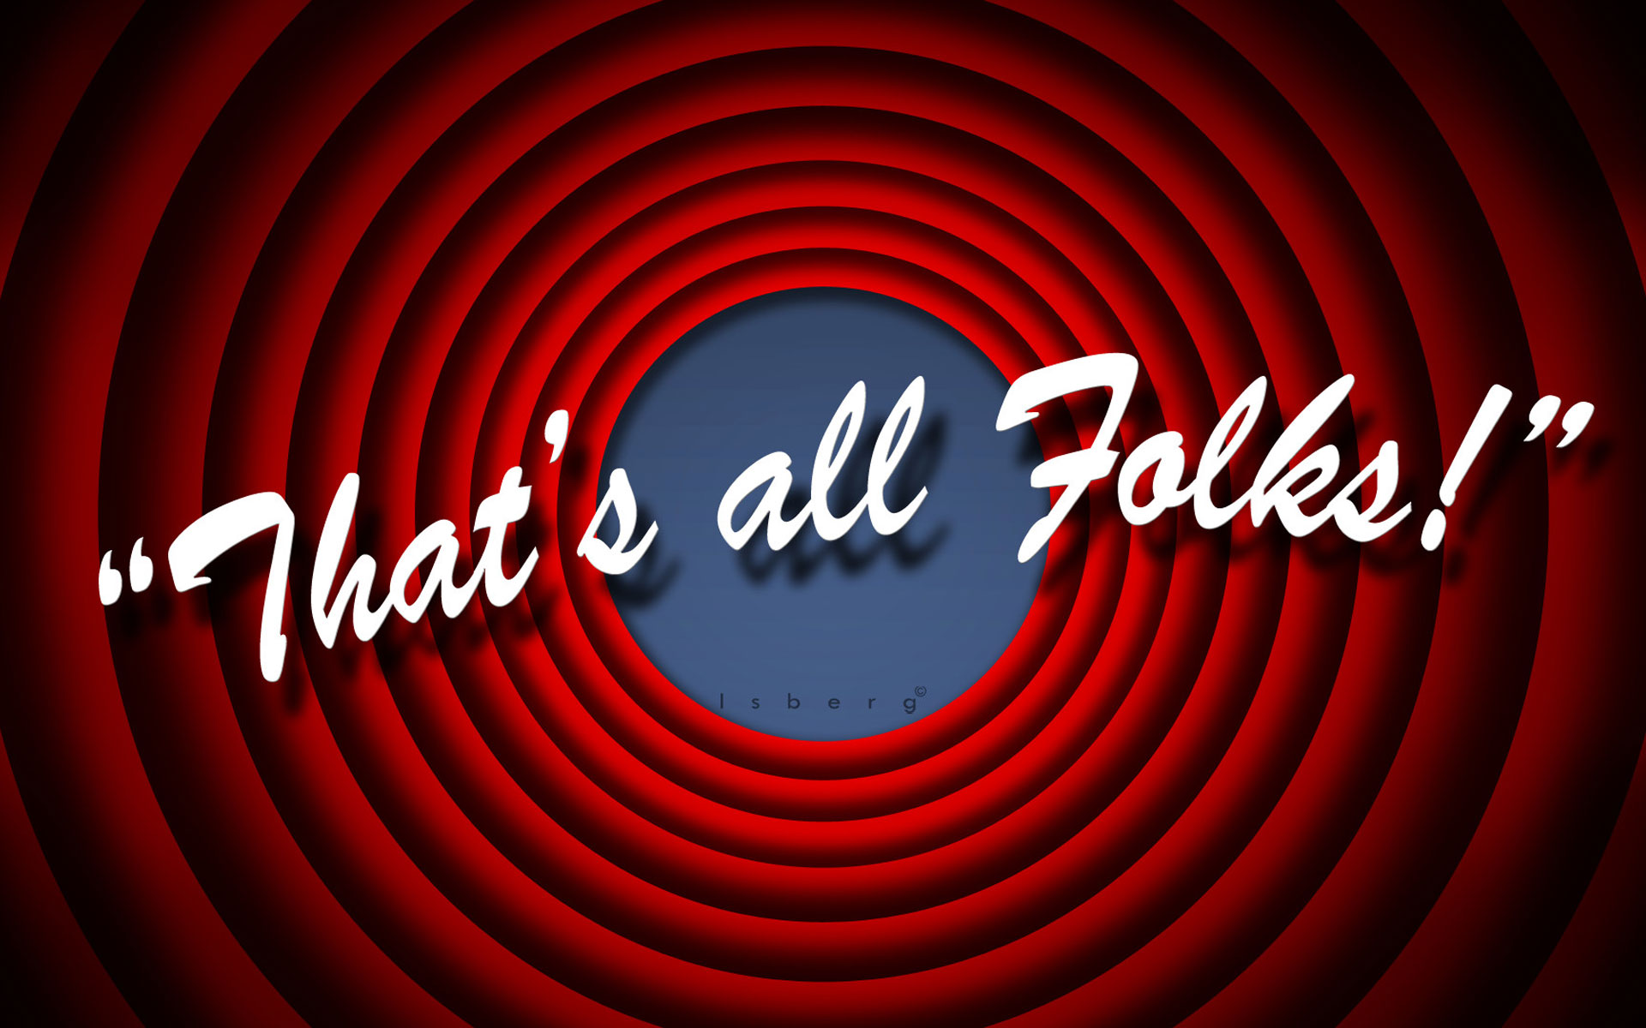
Until Next Season
- Z

